Slide 1

CAPSTONE PROJECT
SMART STUDY PLANNER
Presented By:
1.Abdalah Ansari Abdul Rozack - Mohamed Sathak Aj College Of Engineering - Computer Science And Engineering

Slide 2
OUTLINE
Problem Statement
System Development Approach
Algorithm & Deployment
Result
Conclusion
References

Slide 3
Problem Statement
Students struggle to organize study schedules effectively.
Deadlines and tasks are often forgotten or scattered across apps/notes.
Lack of a single, simple offline tool for tracking daily study tasks and progress.
Motivation decreases when students cannot visualize their progress.
Inconsistent study habits arise due to poor task management.

Slide 4
System Approach
Frontend Technologies:
HTML5 – Structure of the webpage
CSS3 – Styling and responsive layouts
JavaScript – Dynamic interactivity
Design Approach:
Clean and user-friendly interface
Mobile-responsive design
Modular separation of HTML, CSS, and JS files

Slide 5
Algorithm & Deployment
Add Task:
Validate inputs → create task object → push to array → save in LocalStorage → render → success message.
Render Tasks:
Loop tasks → display with checkbox + delete button → update progress bar.
Mark Complete:
On checkbox change → update completed status → save → refresh UI.
Delete Task:
Remove task from array → save → re-render.
Motivational Quotes:
Use timer → randomly display a new quote every few seconds.
Deployment — Step by Step
Local Testing: open index.html in a browser.
Optional local server: run python -m http.server.
GitHub Pages:
Push project to repo.
Enable GitHub Pages in settings.
Access published URL.
Alternative hosting: Netlify or Vercel → connect repo or drag-and-drop folder.

Slide 6
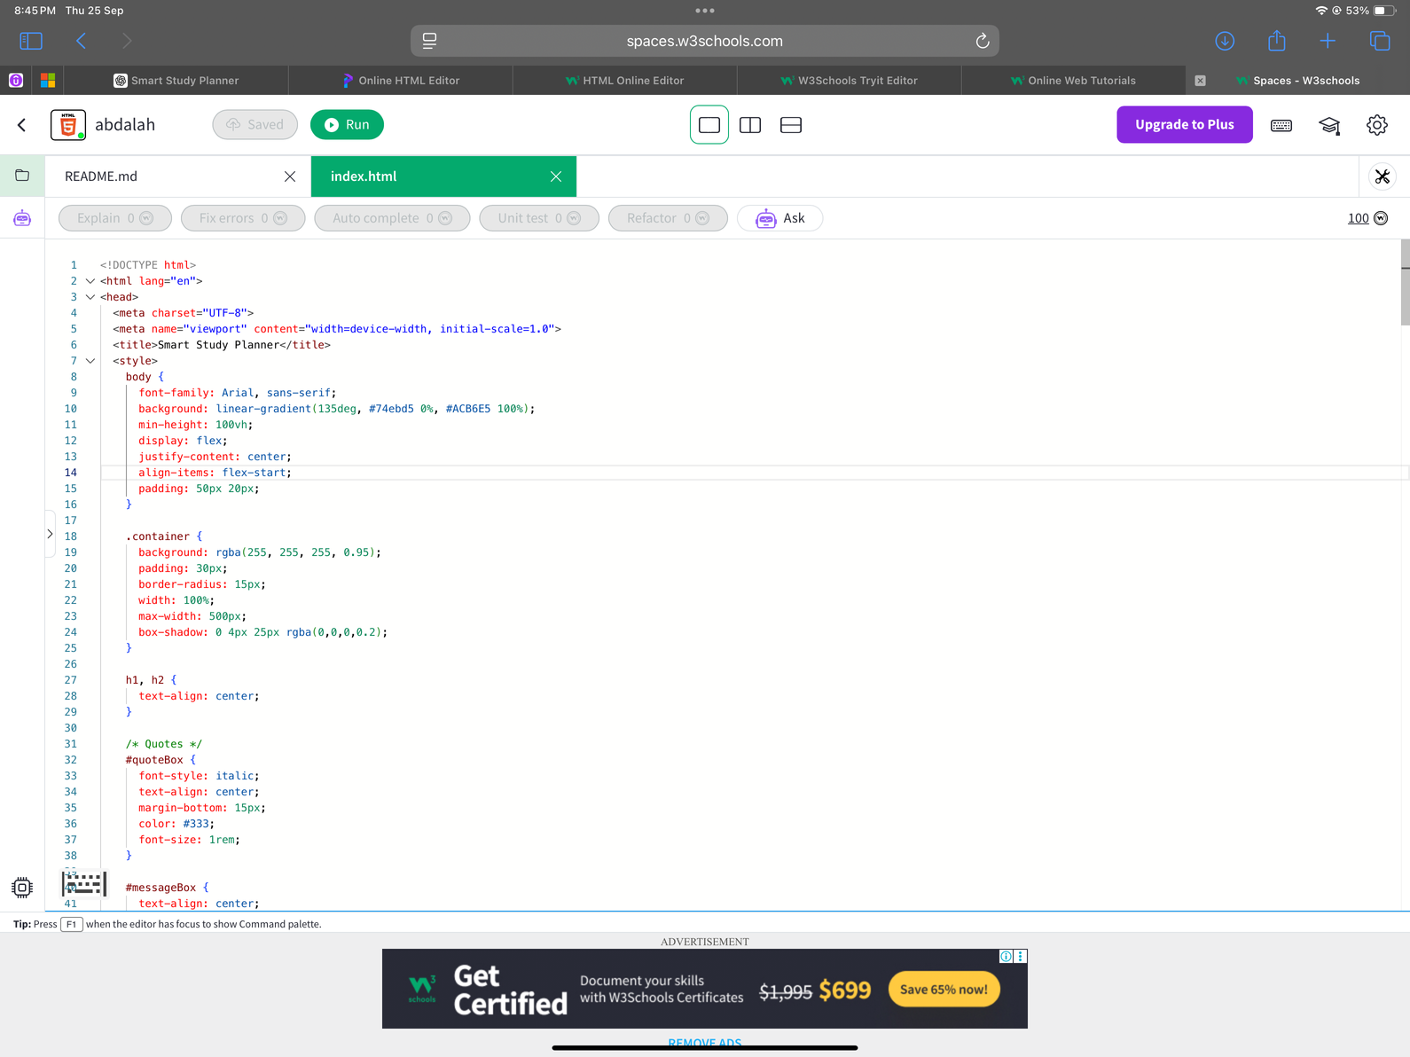
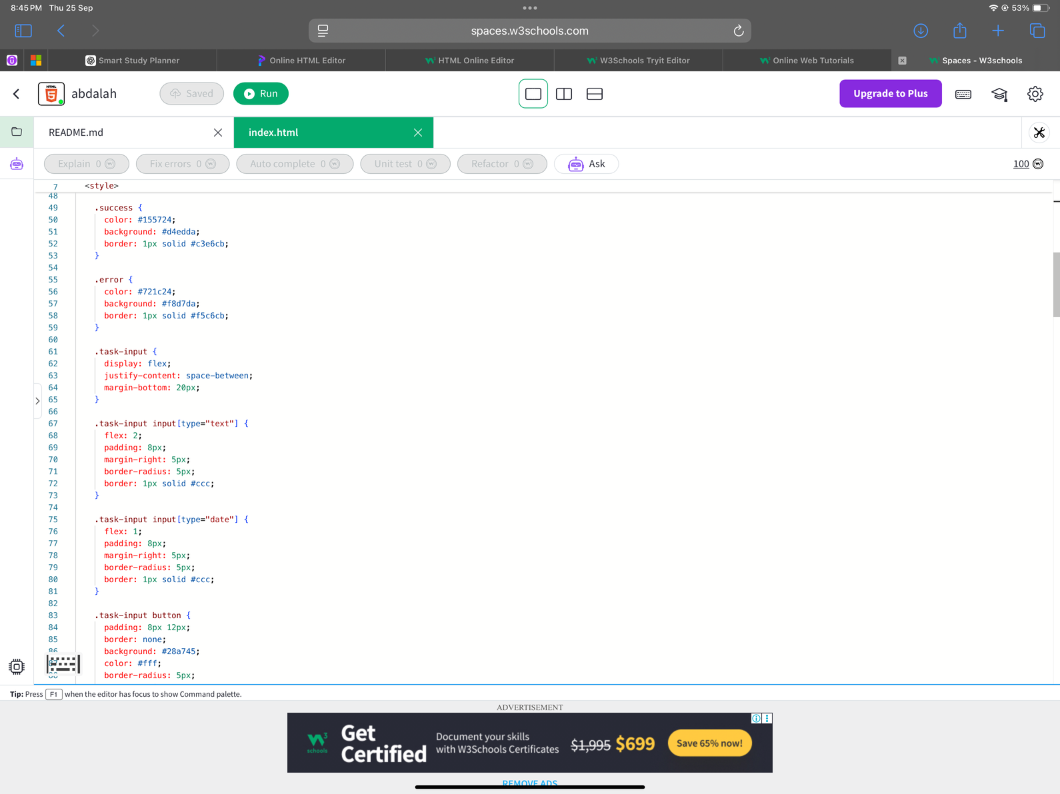
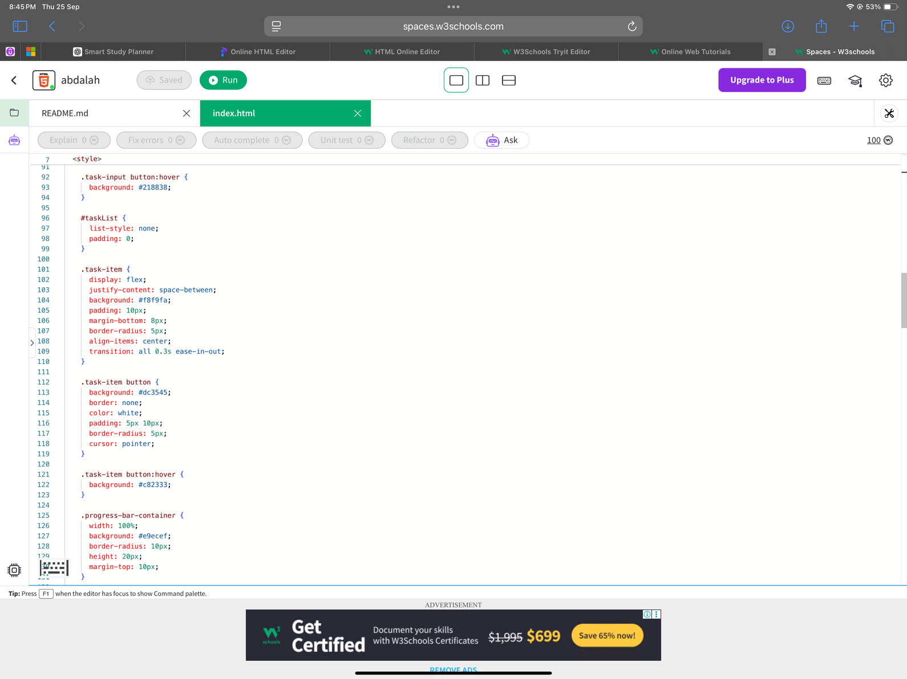
ATTACH SCREEN SNAPS OF THE CODE
Result

Slide 7
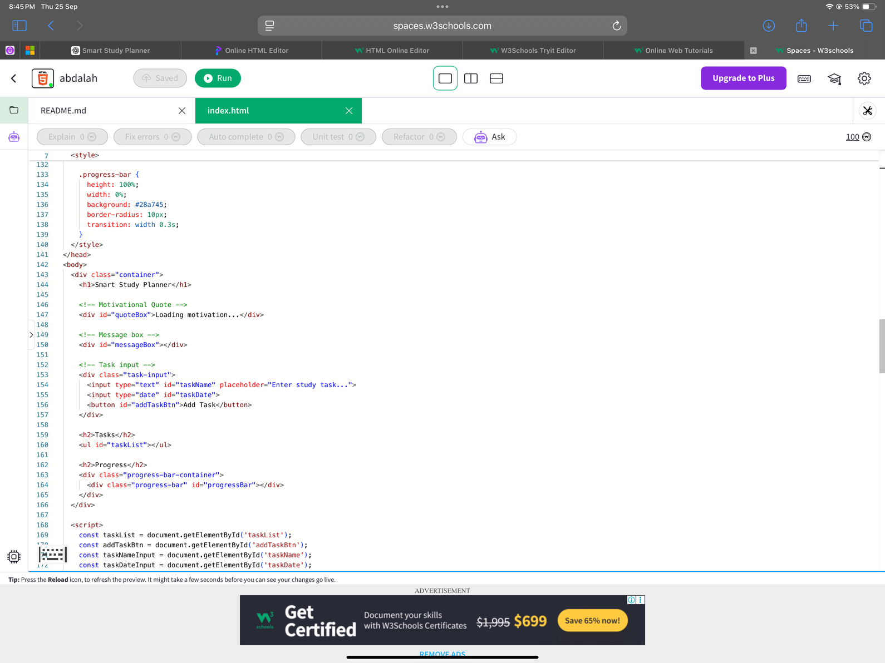
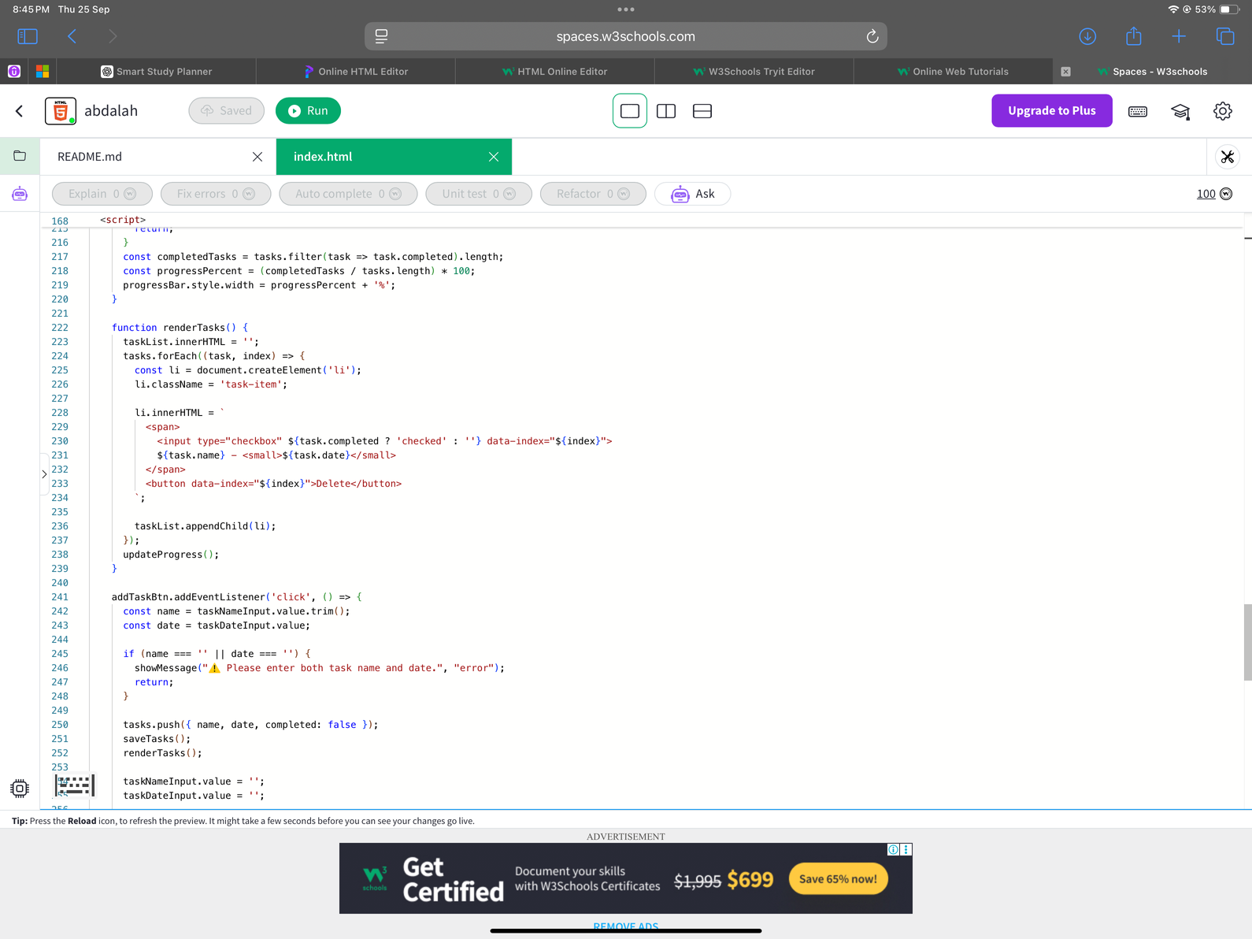
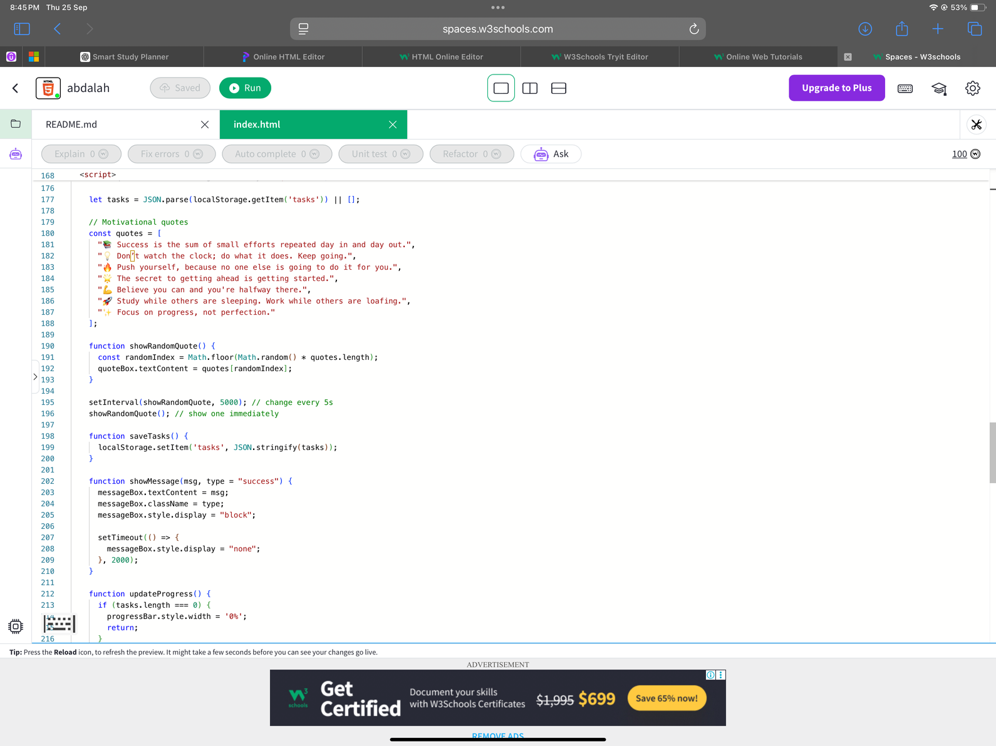
ATTACH SCREEN SNAPS OF THE CODE
Result

Slide 8
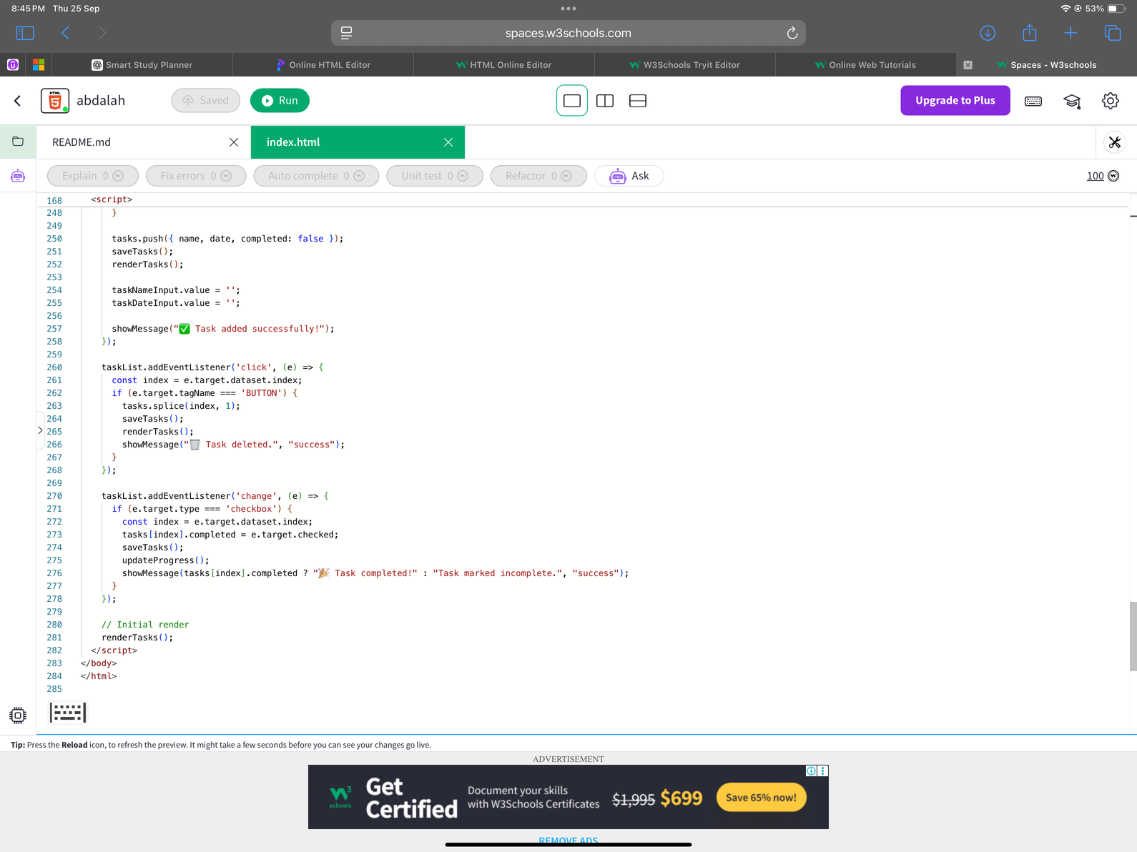
ATTACH SCREEN SNAPS OF THE CODE
Result

Slide 9
ATTACH SCREEN SNAPS OF THE CODE
Result

Slide 10
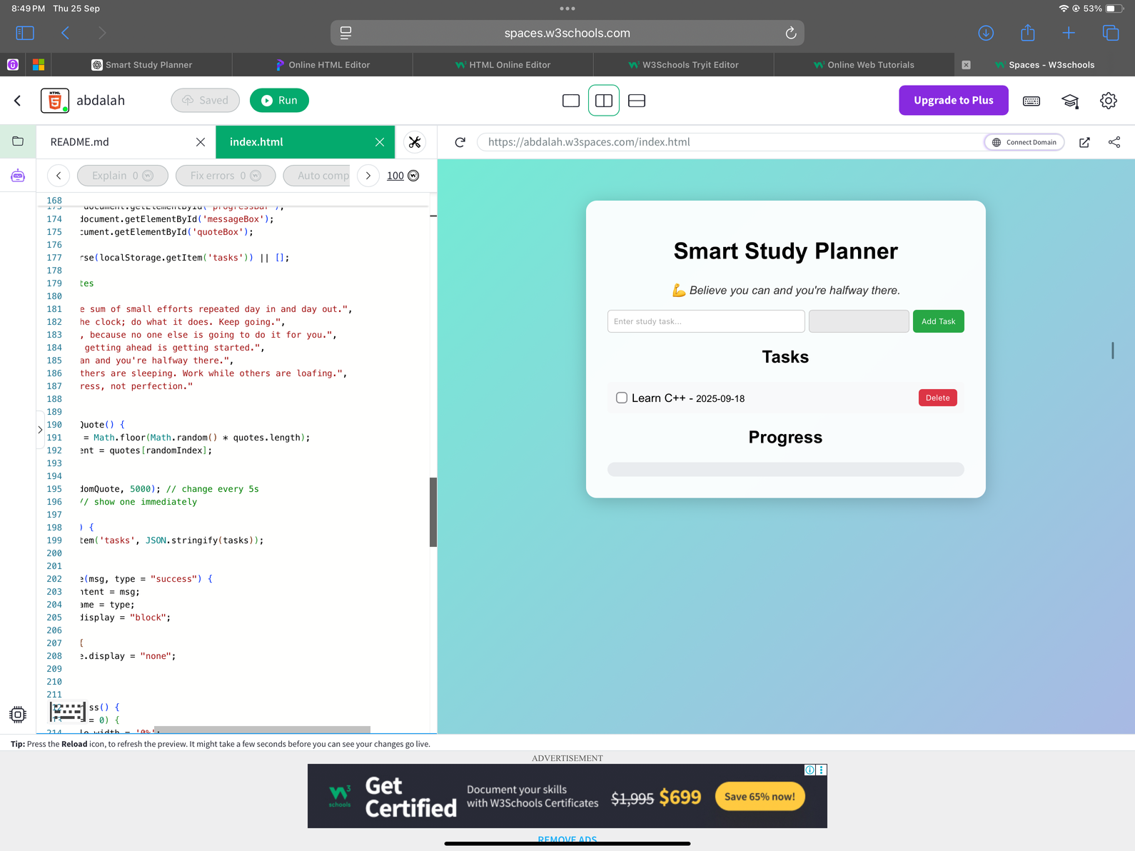
SCREEN SNAPS OUTPUT
Result

Slide 11
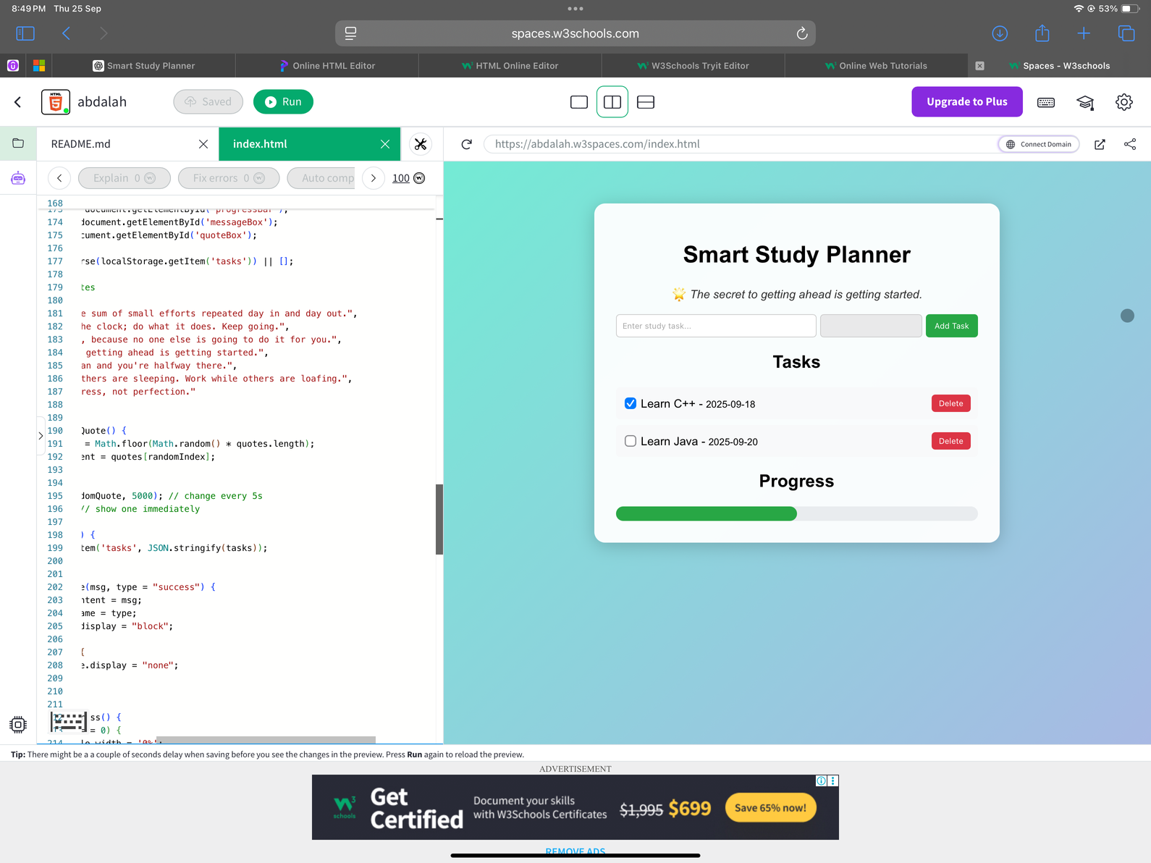
SCREEN SNAPS OUTPUT
Result

Slide 12
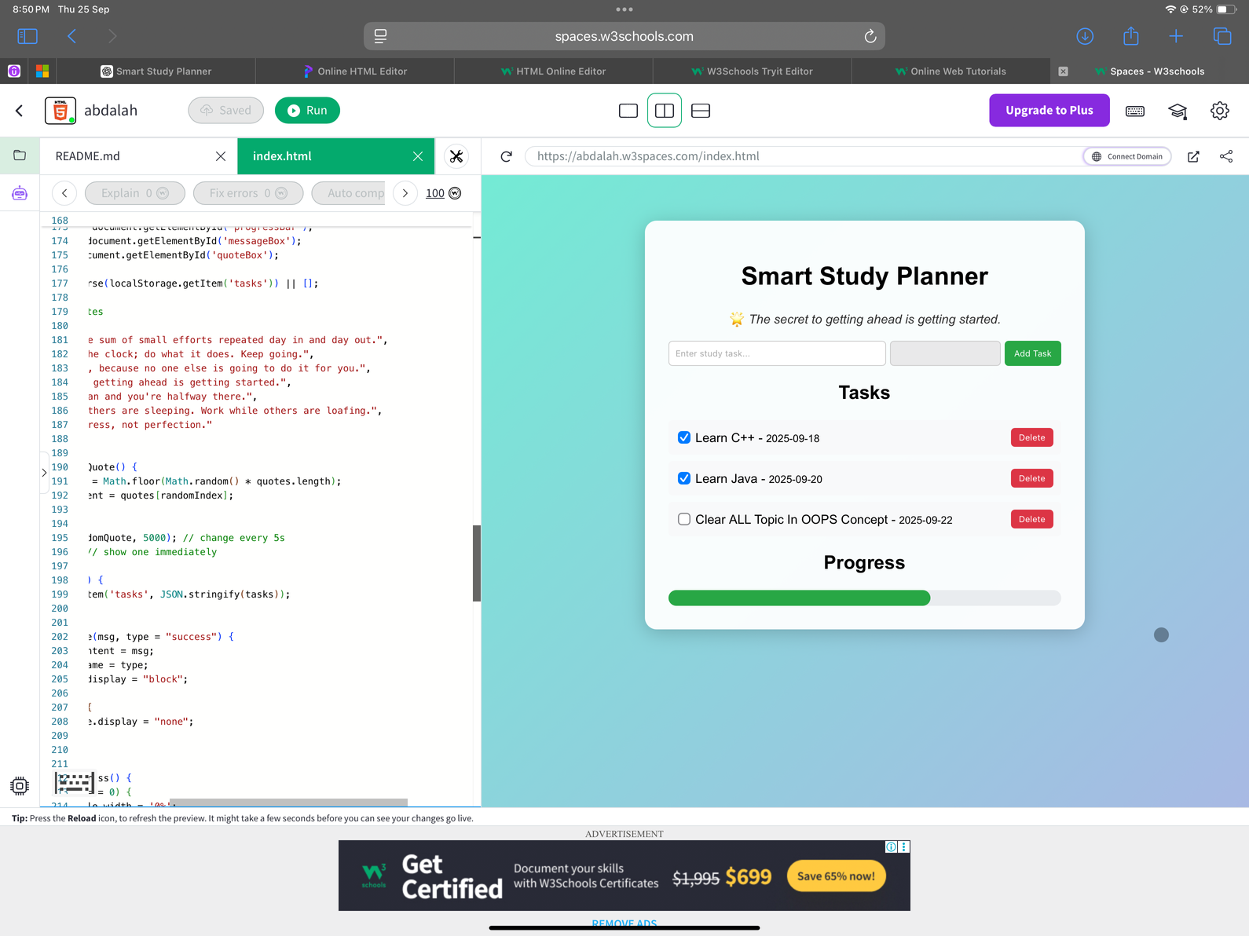
SCREEN SNAPS OUTPUT
Result

Slide 13
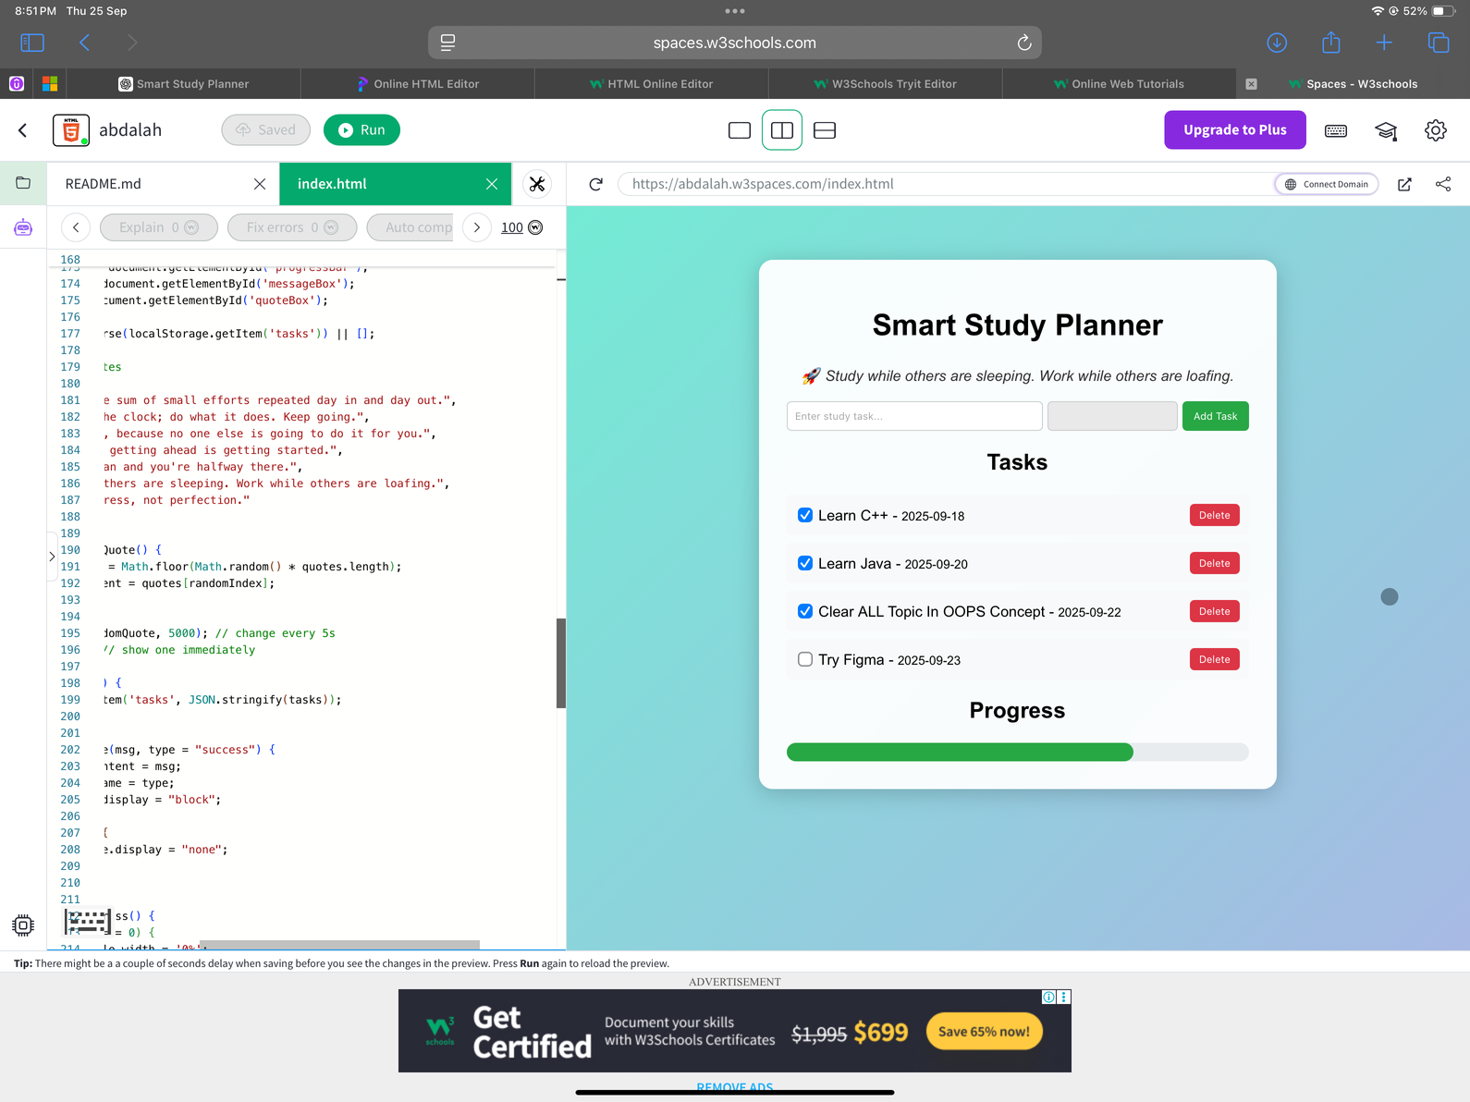
SCREEN SNAPS OUTPUT
Result

Slide 14
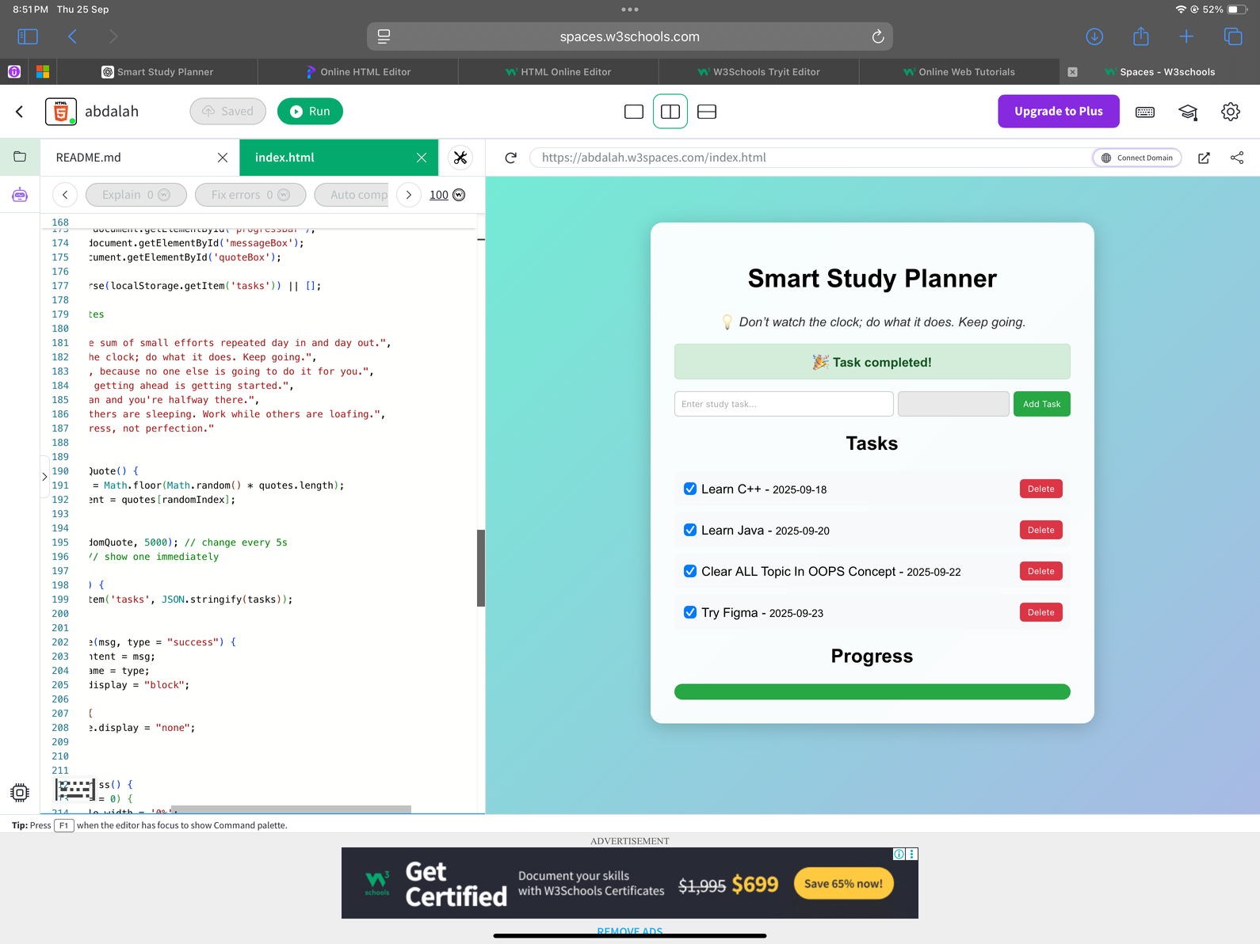
Result
SCREEN SNAPS OUTPUT
https://github.com/Abdalahansa/Smart-Study-Planner

Slide 15
Conclusion
The planner provides a lightweight, offline-first tool to manage study schedules.
Helps improve time management and consistency.
Offers motivational support alongside task management.
Demonstrates the effectiveness of simple web technologies for solving student productivity challenges.

Slide 16
References
MDN Web Docs. HTML, CSS, JavaScript, LocalStorage API. Retrieved from: https://developer.mozilla.org/
BMC Psychology (2025). Unlocking academic success: the impact of time management on study engagement.
Behavioral Sciences (2025). Predicting Academic Performance from Future-Oriented Daily Time Management Behavior.
PJSEL (2021). A Study of Relationship Between Time Management Skills and Learning Motivation of University Students.

Slide 17
THANK YOU

